Slide 1

Selection sort algorithm & implementation in java
-- #greenlearner --

Slide 2
Input/Output
Input
Unsorted integer elements
Output
Sorted integer array
9 | 8 | 7 | 6 | 5 | 4
4 | 5 | 6 | 7 | 8 | 9

Slide 3
Steps/Algorithm
Divide the input unsorted data set into two parts
Left –sorted – mark it the front of the data set and point towards left
Right – unsorted – mark it front of the data set and point towards right
Now pick least element from the unsorted data set
Swap the first position of sorted array with position of least element found in step2
Repeat till all the elements from right data set are empty
9 | 8 | 7 | 6 | 5 | 4
4 | 8 | 7 | 6 | 5 | 9
4 | 5 | 7 | 6 | 8 | 9
4 | 5 | 6 | 7 | 8 | 9
4 | 5 | 6 | 7 | 8 | 9
4 | 5 | 6 | 7 | 8 | 9
4 | 5 | 6 | 7 | 8 | 9

Slide 4
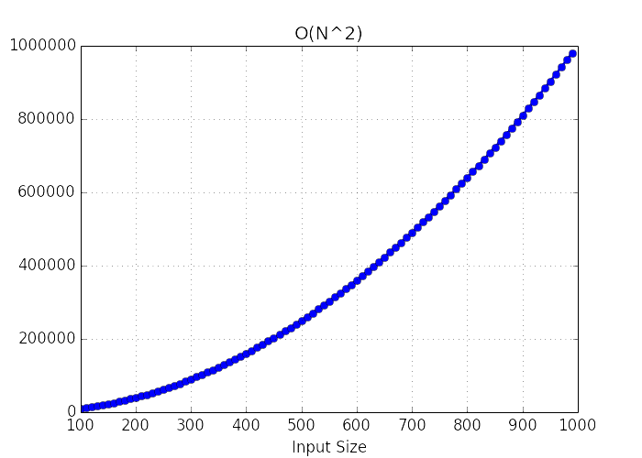
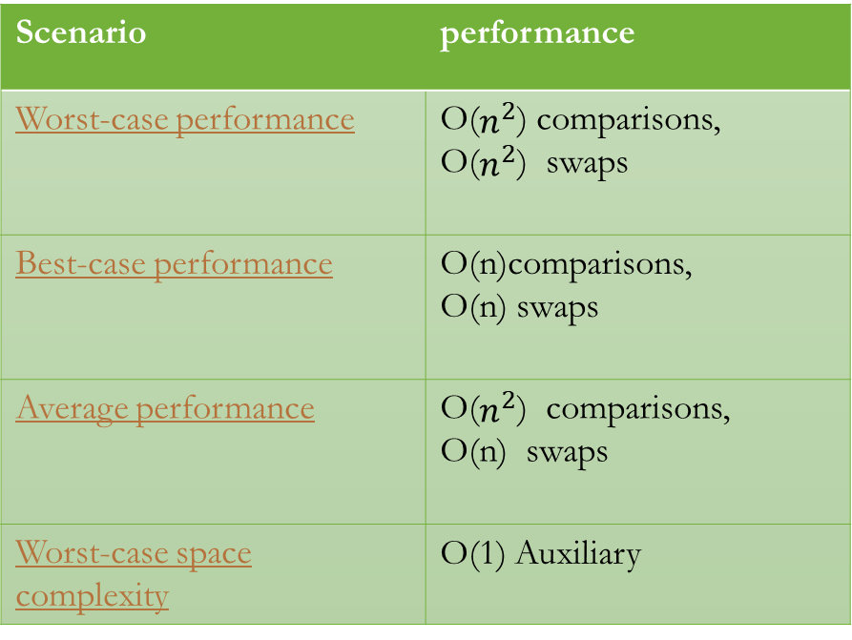
Performance Analysis
Scenario | performance
Worst-case performance | O($n^{2}$) comparisons, O($n^{2}$) swaps
Best-case performance | O(n)comparisons, O(n) swaps
Average performance | O($n^{2}$) comparisons, O(n) swaps
Worst-case space complexity | O(1) Auxiliary

Slide 5
Where and when to use??
Selection sort is noted for its simplicity.
has performance advantages over more complicated algorithms in certain situations, particularly where auxiliary memory is limited.
Inefficient on large lists.

Slide 6
References..
https://en.wikipedia.org/wiki/Selection_sort

Slide 7
Next..

